Slide 1



Slide 2


CALIFORNIA
600mmx1200mm
Porcelain/ Polished/ Soft Matt

Slide 3


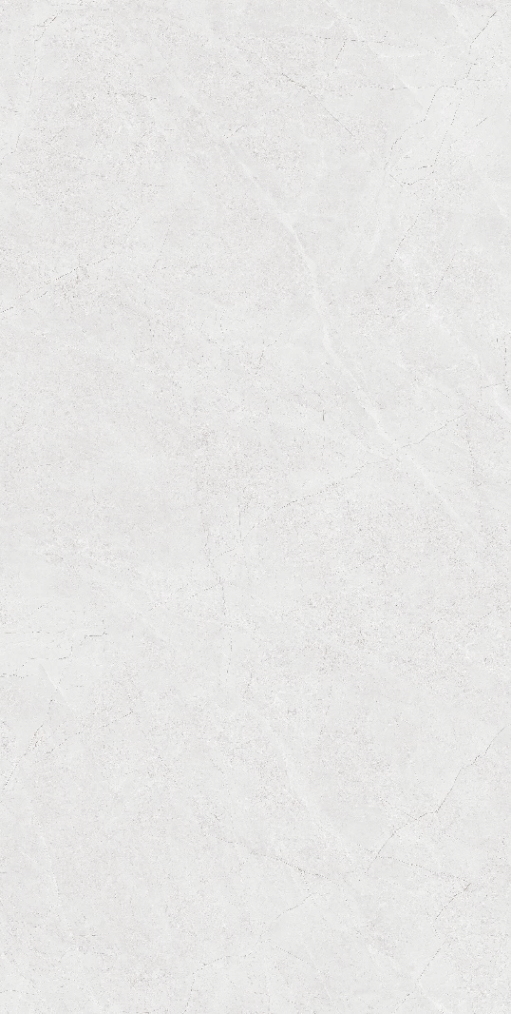
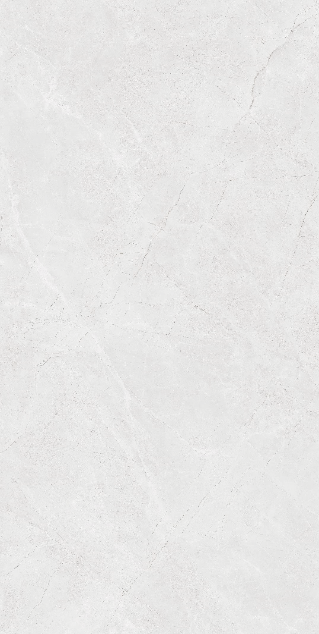

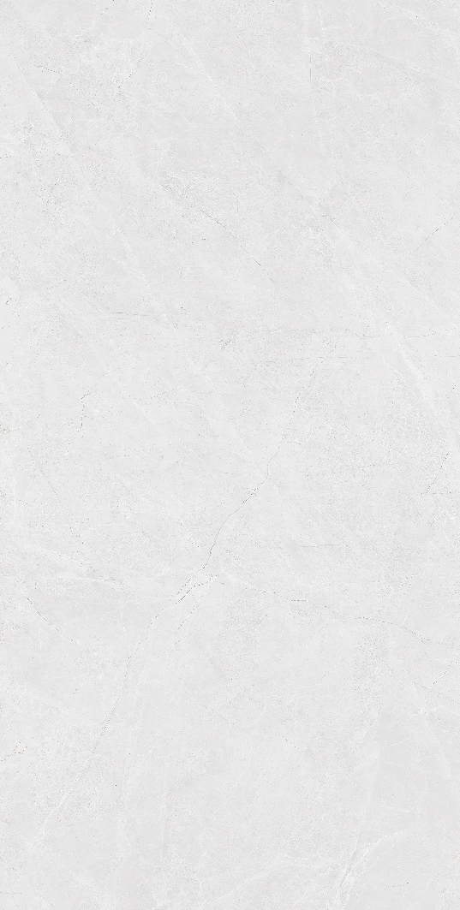
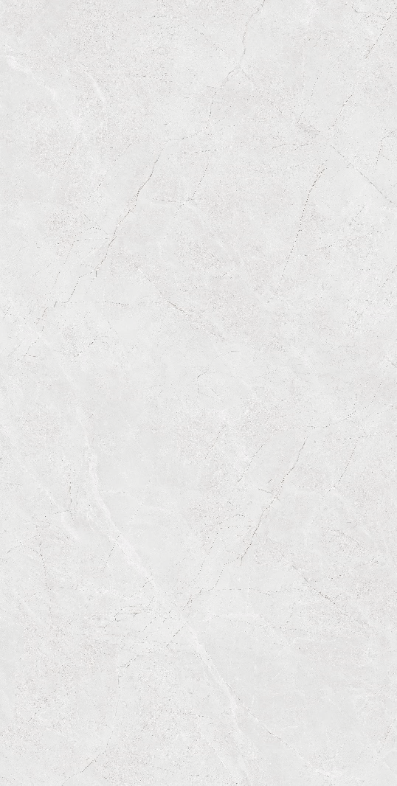
CALIFORNIA
CA25-GP61201 600mmx1200mm Porcelain/ Polished/ 05 face

Slide 4
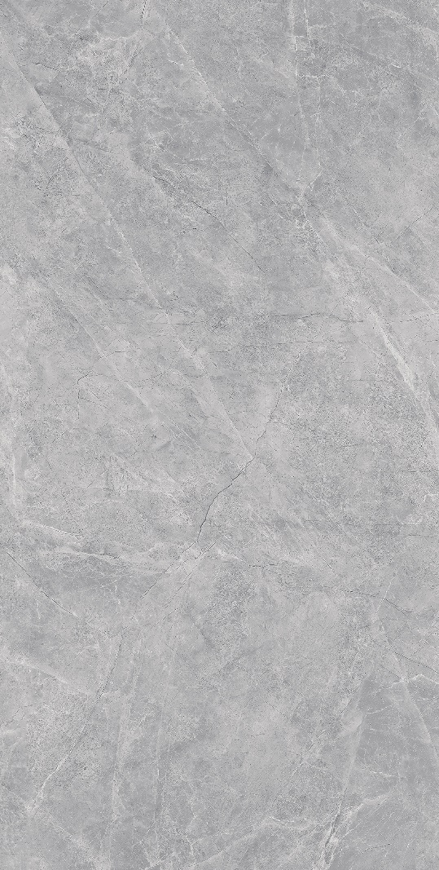
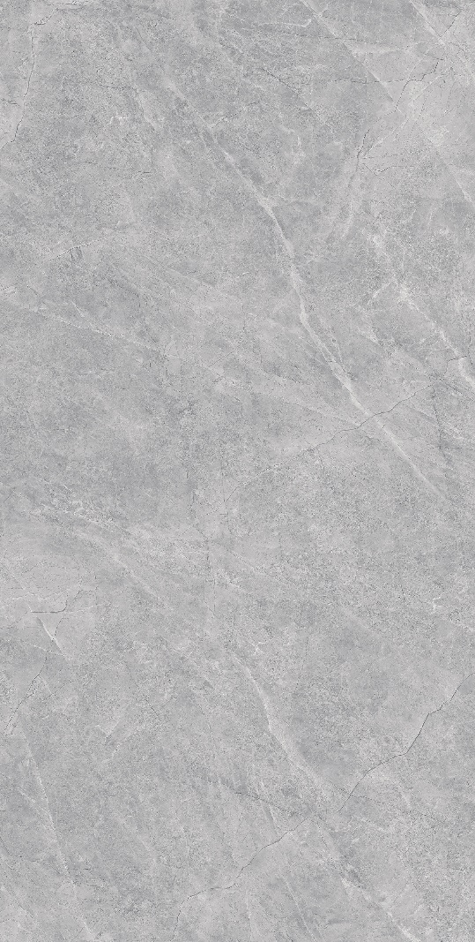
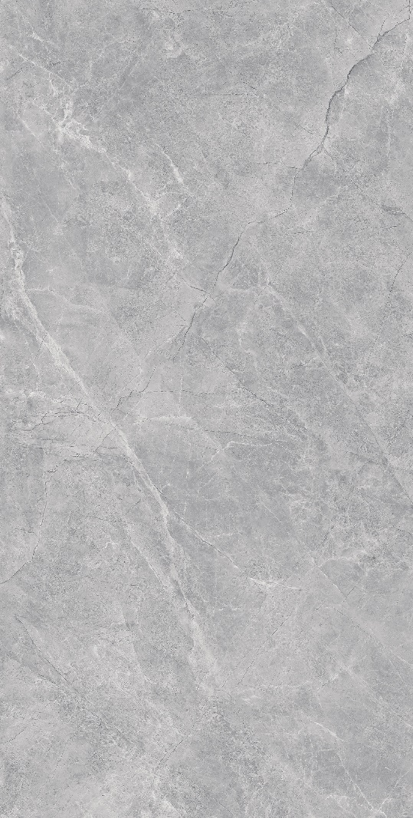
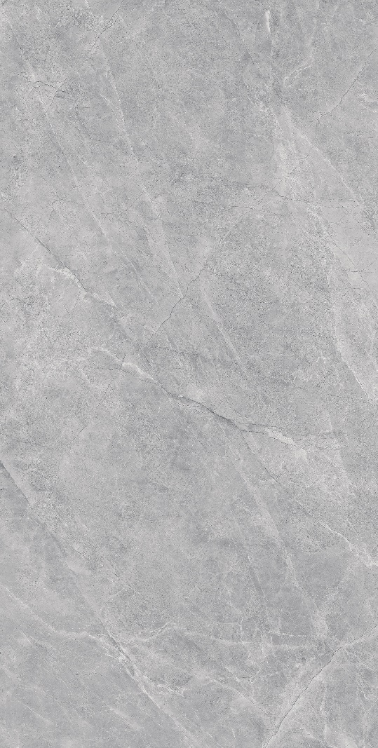
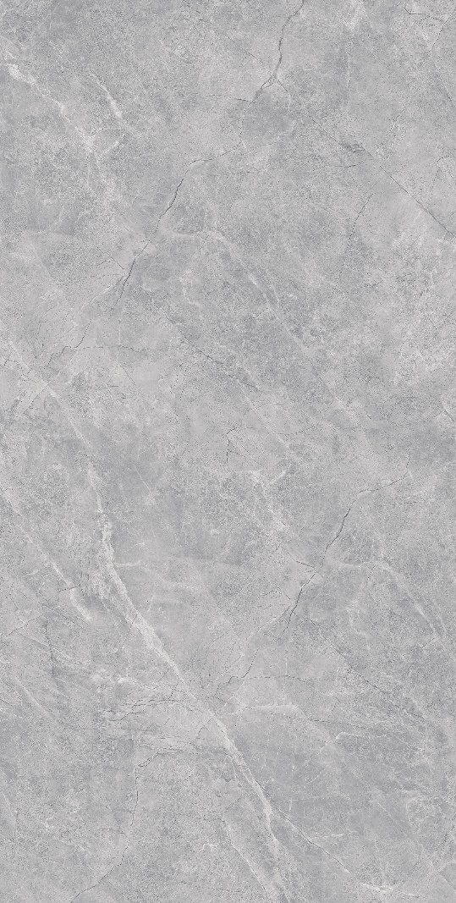
CALIFORNIA
CA25-GP61202 600mmx1200mm Porcelain/ Polished/ 05 face

Slide 5
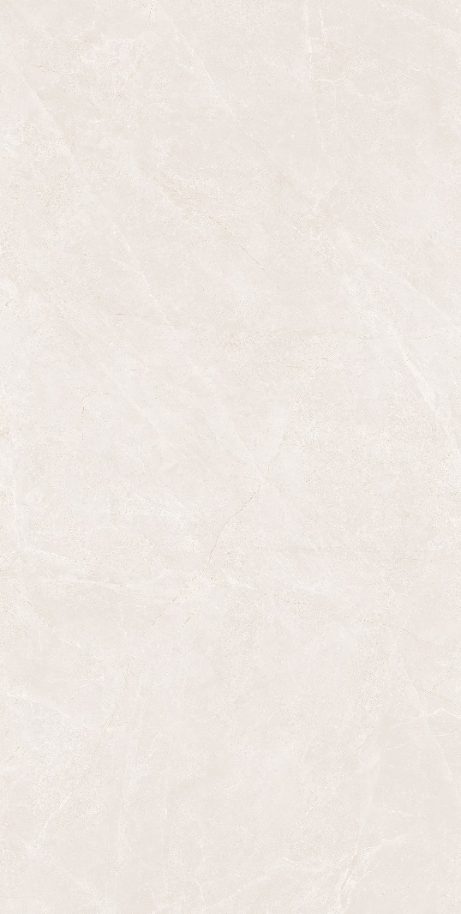

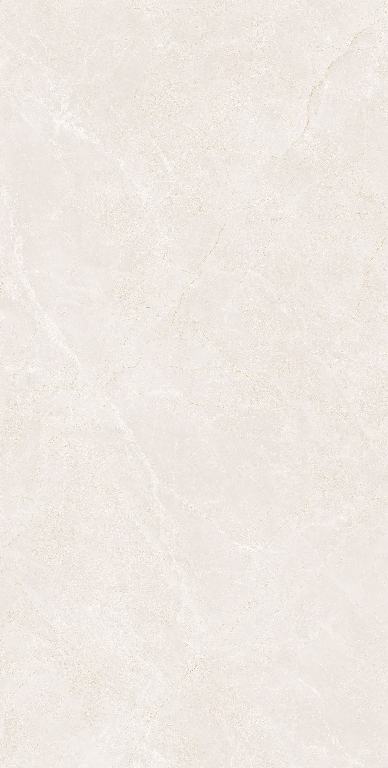
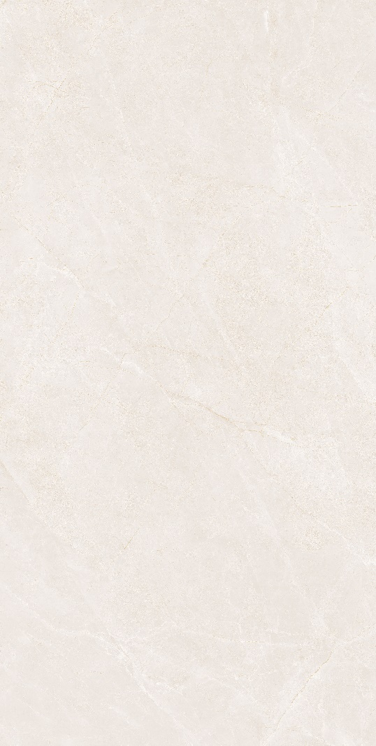
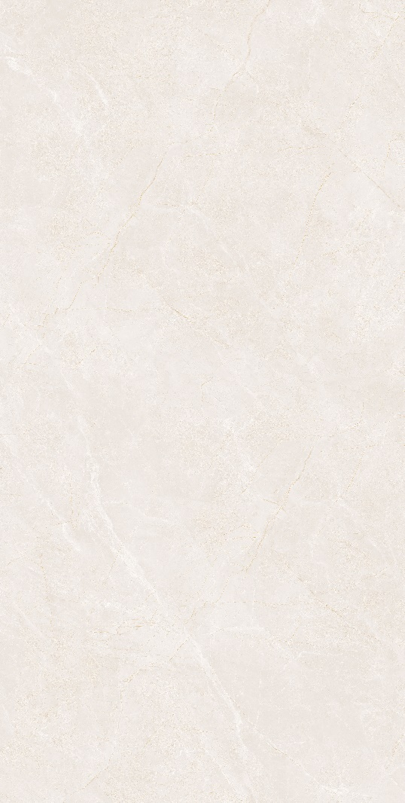
CALIFORNIA
CA25-GP61203 600mmx1200mm Porcelain/ Polished/ 05 face

Slide 6
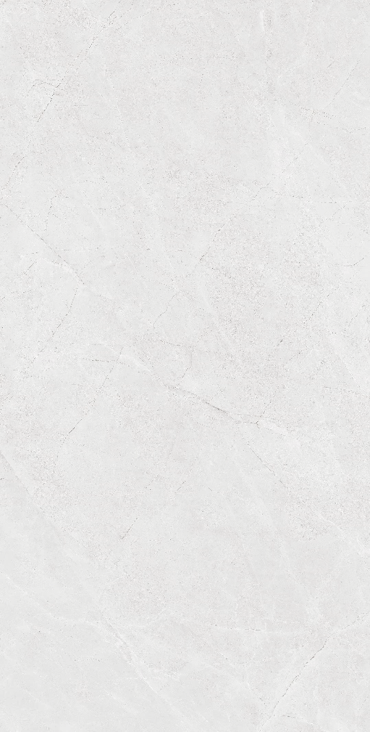
CALIFORNIA
CA25-GSM61201 600mmx1200mm Porcelain/ Soft Matt / 05 face

Slide 7
CALIFORNIA
CA25-GSM61202 600mmx1200mm Porcelain/ Soft Matt / 05 face

Slide 8

THANK YOU

